Slide 1


Project Presentation (KCS 753) (KRISHAK)
KIET Group of Institutions, Ghaziabad
(An ISO – 9001: 2008 Certified & ‘A+’ Grade accredited Institution by NAAC)
Guide Name:
Project Members Name with Roll Number & Section
1.NANCY SRIVASTAVA(2100290120109)CS-B
2. TUSHTEE SINGH(2100290120176)CS-C
3. KUSHAGRA SINGH(2100290120099)CS-B
4.SURABHI AGNIHOTRI(2100290120169)CS-C

Slide 2
Problem Statement
The challenge is to create an affordable farm equipment sharing platform that addresses the pressing need for cost-effective access to agricultural machinery among small and medium-sized farmers, fostering increased productivity and sustainability in agriculture.

Slide 3
Objectives
To create an accessible, web-based platform that connects farmers seeking specific types of farm equipment with equipment owners who are willing to share or rent their machinery
To substantially reduce the financial burden on small and medium-sized farmers by enabling them to access required farm equipment at a fraction of the cost of ownership.
To enhance the efficiency and utilization of farm equipment by implementing intelligent scheduling and resource allocation algorithms that minimize downtime.

Slide 4
Technology Used
HTML
CSS
JavaScript
React JS
Python
Payment Processing APIs
Web Framework
Django Rest Framework
MySQL

Slide 5
Literature Survey
Survey should be explained with the following parameters:
Paper title
Author name
Journal Name
Year of publishing
Followed by Summary of papers.

Slide 6
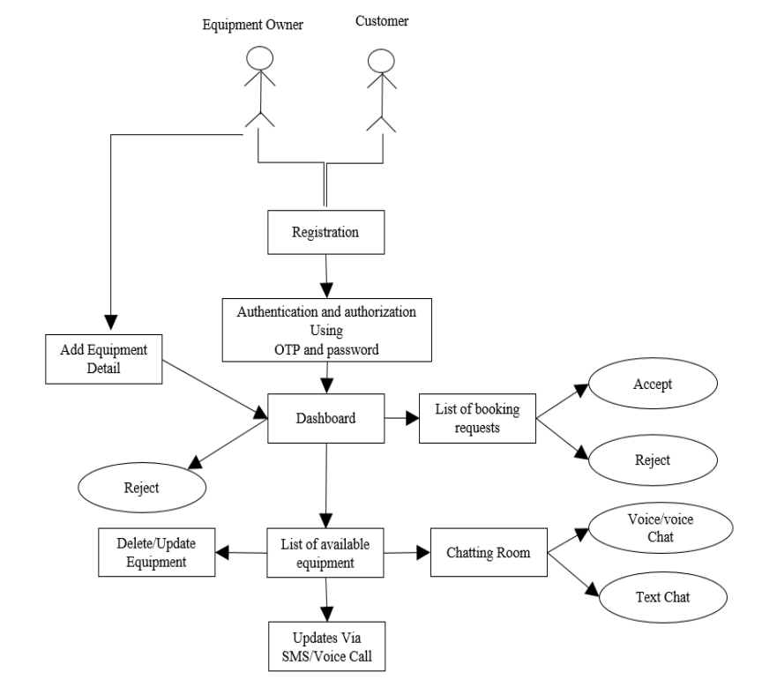
Workflow Diagram

Slide 7
Patent Status
Soft copy proof of submission/ publication.

Slide 8
Research Paper Status
Soft copy proof of submission/ publication.
Draft completion status

Slide 9
Project Status
How much project is completed with screenshot of the output domains.
Working project

Slide 10
References
All mentioned references should be in IEEE format.

